Slide 1
Test Automation on IBM i
Proof of Concept
Nourilee Santos, Application Developer – RPG
March 2017

Slide 2
What is Automation Testing?
Manual testing is performed by a human sitting in front of a computer carefully executing the test steps.
Automation Testing means using an automation tool to execute your test case suite.
Automated software testing is important due to following reasons:
Manual Testing of all work flows, all fields , all negative scenarios is time and cost consuming
It is difficult to test for multi lingual sites manually
Automation does not require Human intervention. You can run automated test unattended (overnight)
Automation increases speed of test execution
Automation helps increase Test Coverage
Manual Testing can become boring and hence error prone.
What is
Automation Testing?
Why Automated Testing?
http://www.guru99.com/automation-testing.html
Notes:
Manual Testing and Automation Testing are both self-explanatory, but just to put meaning on these terms, we can say that Manual Testing is that activity performed by a human sitting in front of a computer carefully executing the test steps, while in Automation Testing we are using an automation tool to execute the test cases.

Slide 3
Which Test Cases to Automate?
Test cases to be automated can be selected using the following criterion to increase the automation ROI
High Risk - Business Critical test cases
Test cases that are executed repeatedly
Test Cases that are very tedious or difficult to perform manually
Test Cases which are time consuming
The following category of test cases are not suitable for automation:
Test Cases that are newly designed and not executed manually at least once
Test Cases for which the requirements are changing frequently
Test cases which are executed on ad-hoc basis.
Which Test Cases to Automate?
http://www.guru99.com/automation-testing.html

Slide 4
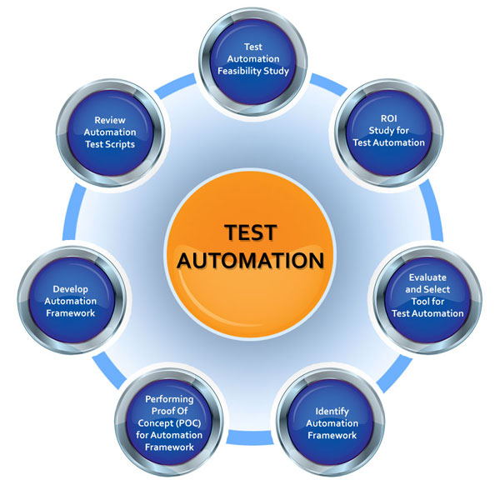
Automation Process
Notes:
Test planning, design, builds, execution, analysis, verification, validation, and reporting are phases which include defect tracking, software and system configuration management, and software metrics, all working together and ultimately adhering to each other as a unified process of effective management strategies. The appropriate automation works in these testing situations to varying degrees, depending upon how the testing process is managed.
Reference: https://www.getzephyr.com/insights/using-best-practices-within-scope-automation

Slide 5
Evaluate and Select Tool for Test Automation
RFT limitations:
1. Test environment is invalided after Browser/Java/RFT version updated.
2. Different screen resolution reduces the test case pass rate.
3. Dynamic recognize is with low efficiency and slow.
4. Slow execution speed.
5. Large number of maintenance workload spent on RFT object map.
6. Difficult to support other browsers.
7. Cursor locked.
These limitations cause the instability and slowing of our automation execution, it cannot achieve our target of unattended execution.
Such as the RFT is strictly limited with browser version, java version, and RFT version, any update to a new version will impact current execution environment.
And automation scripts in RFT cannot support different screen resolution, and difficult to support other browsers as well.
In RFT, we use both dynamic recognize and static recognize to find an object. But more and more dynamic recognize make execution become slower and slower. We spend large number of effort to maintain the static object map.
During RFT test case execution, tester cannot move the cursor meanwhile, because the cursor have been use by RFT to do actions in webpages. Any other cursor actions out of RFT will impact the execution and lead failure.
All these limitations are because of the complex and non-lightweight object recognition mechanism (object map) in RFT.
Selenium is the most popular Web UI test automation technology, it's open source, lightweight, and support almost all the mainstream browsers. Through research, we found it have many advantages can make up RFT limitations.

Slide 6
Evaluate and Select Tool for Test Automation
Selenium Advantages:
1. Script execution will be much faster than RFT.
2. Direct operate the Browser's API, better Object recognition efficiency compared to RFT object Map.
3. No need to bother about the Browser/Java version update
4. Scripts can be used for Cross OS & browser testing to execute them on all Selenium supported browsers
The selenium WebDriver API is actually operation the web UI objects from internal by using JavaScript.
It faster than RFT. The object recognition method of selenium is all dynamic recognize, actually in selenium we call web elements instead of the objects map in RFT. We can use WebDriver operate any elements you want to use in web pages, rather than keep a lot of static object map files, just like we did in RFT. We can have many ways to recognize a web element. such as elements id, name, value, visible text, and xPath. And this recognize is more stable and more speed than RFT's dynamic recognize.
Selenium also supports most of browsers, include the latest FireFox version. we do not need to worry about the Browser and Java version update.
And different with RFT, Selenium is easy to do cross browser testing. If you want to run test case on other browsers, you just need to load the specified driver of this browser before start the execution.
Notes:
DevOps is an enterprise capability that enables the continuous delivery, continuous deployment and continuous monitoring of applications.

Slide 7
Scope of Automation
What are we testing
Story 1661047 - IRFS02: BSO requests to change the Billing Invoice Adjustments label to Credit Note when billing amount is negative. No changes to Debit Billing Adjustments label.
How are the testing done?
Execute the setup of parameters prior to testing
Login as Operator
Run a billing adjustment print based on parameters
Assess if billing adjustment print results show that the Credit Note label has been changed when billing amount is negative.
Assess if billing adjustment print results show that the Debit Billing Adjustment label has not been changed

Slide 8
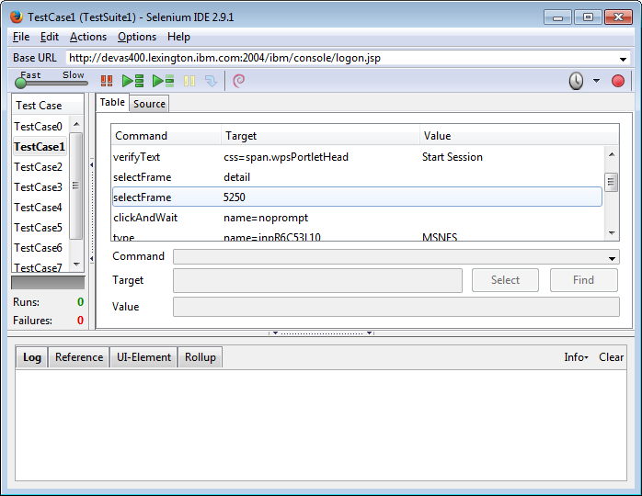
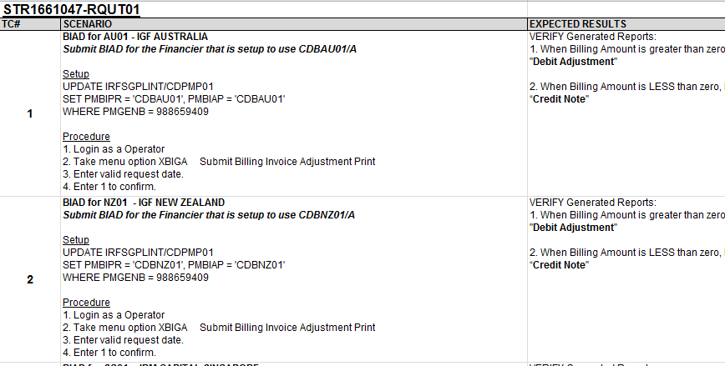
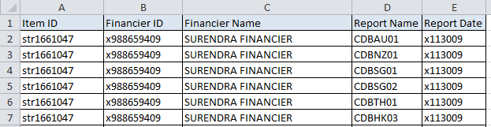
Design and Develop Proof of Concept
Prepare Test Cases & Test Data
Record steps in Selenium IDE
Notes:
We initially recorded our steps in Selenium IDE. Then, we convert this into the TestNG Format.

Slide 9
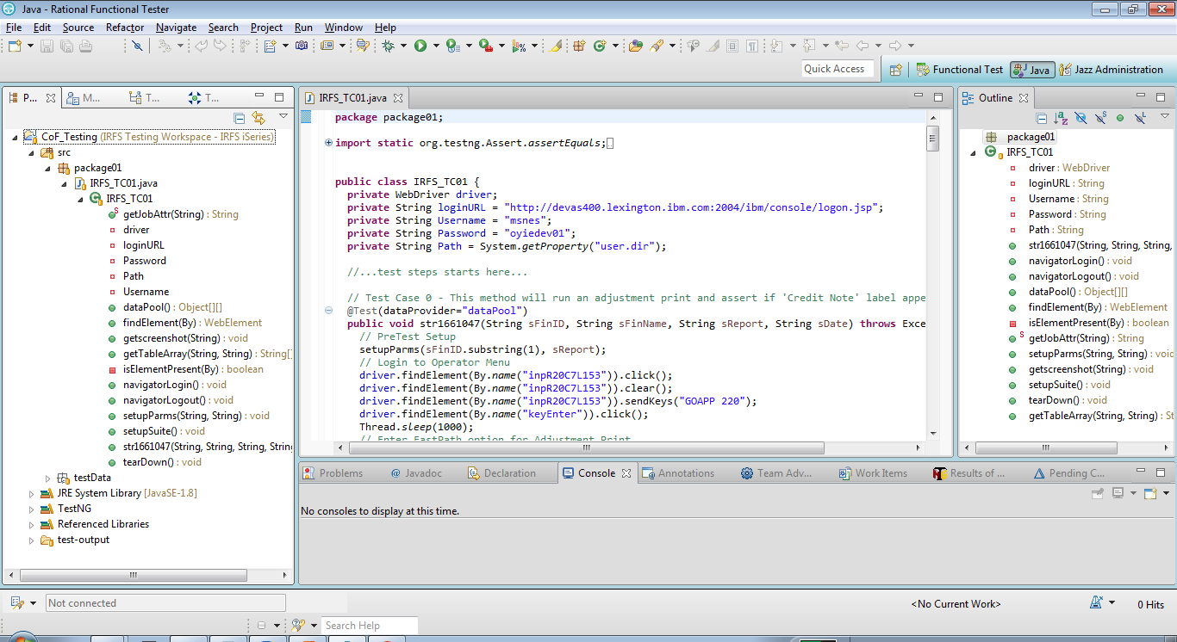
Design and Develop Proof of Concept
Design and Code your Test Script
Notes:
Prior to this, we have learned how to install Selenium Web Driver and Integrate RTC into our Eclipse IDE

Slide 10
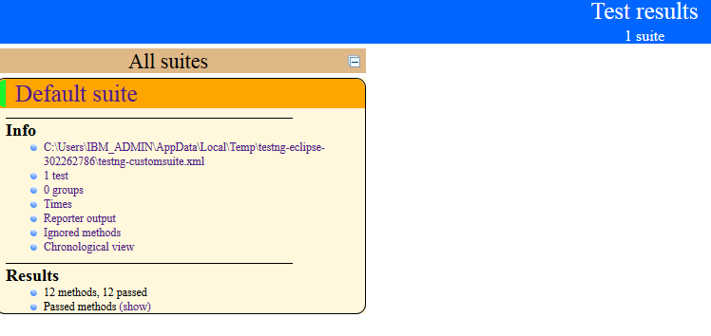
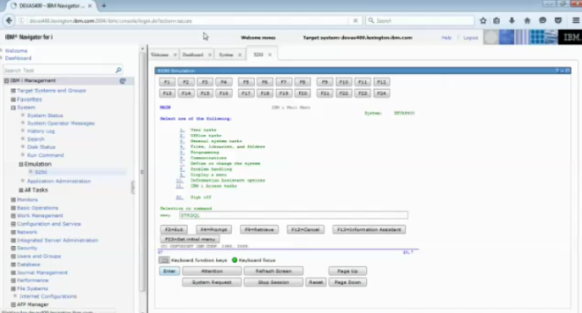
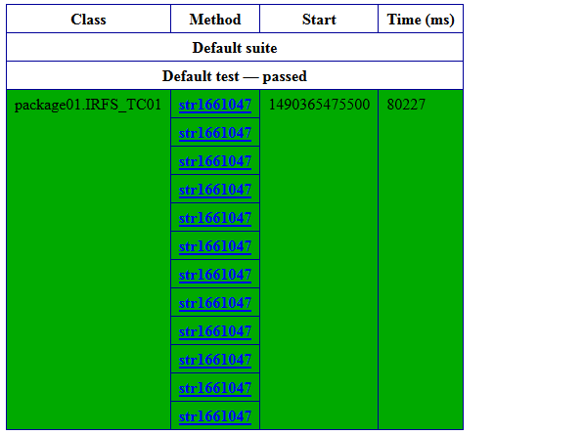
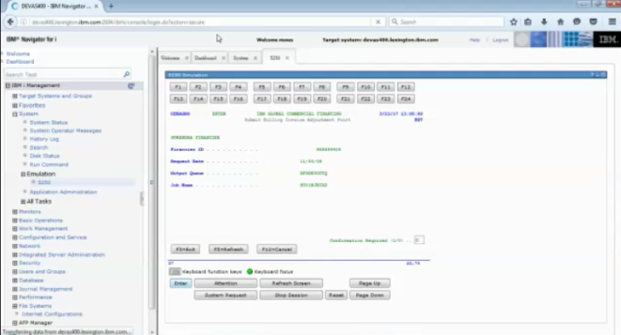
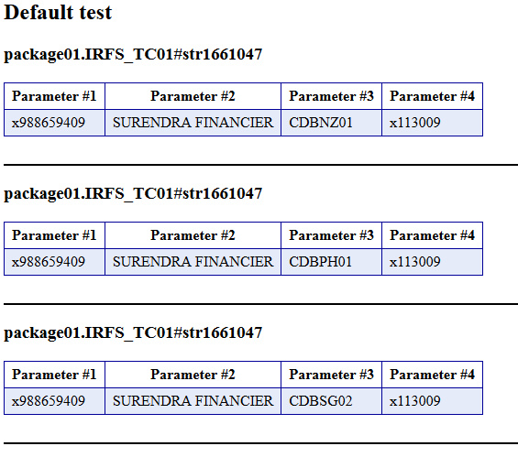
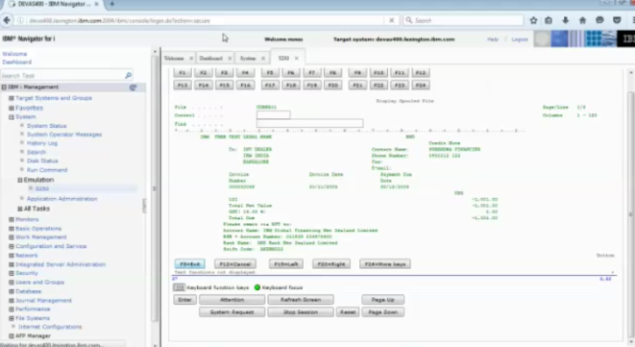
Design and Develop Proof of Concept
Test Results
Test Execution

Slide 11
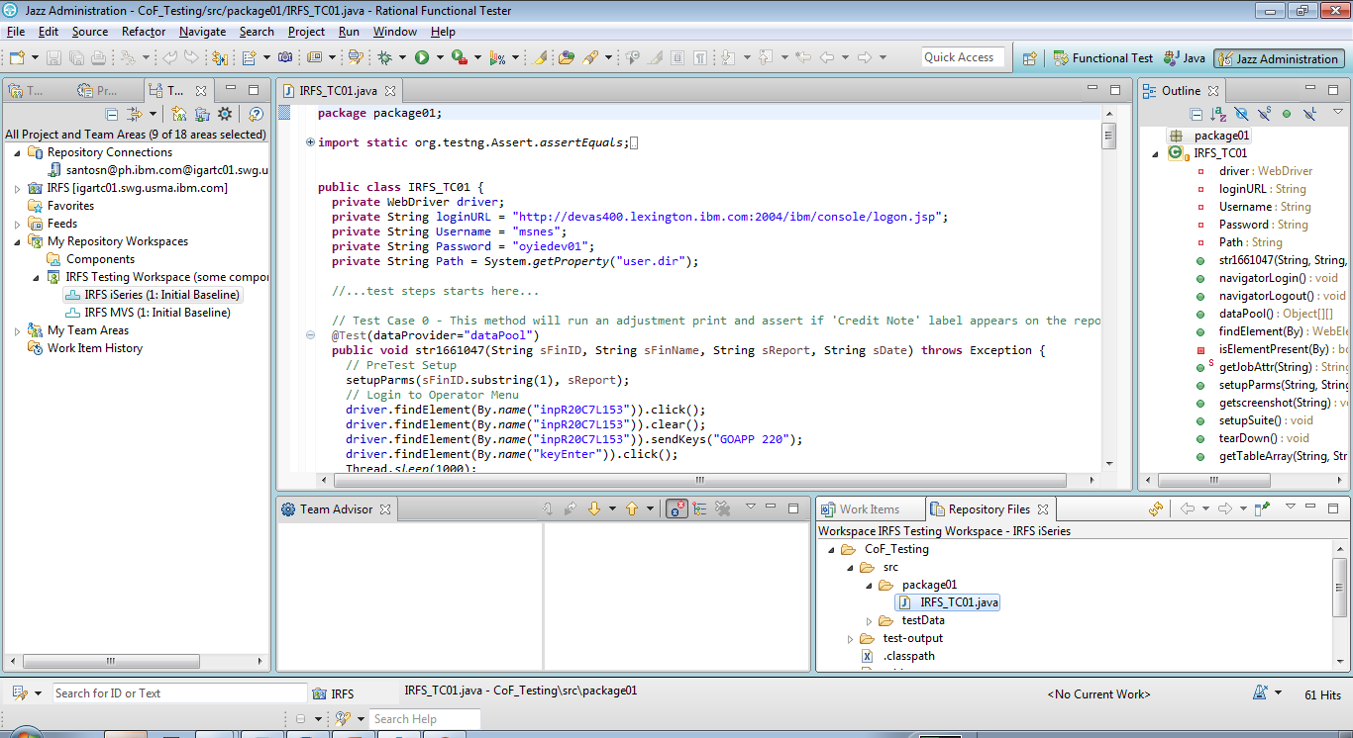
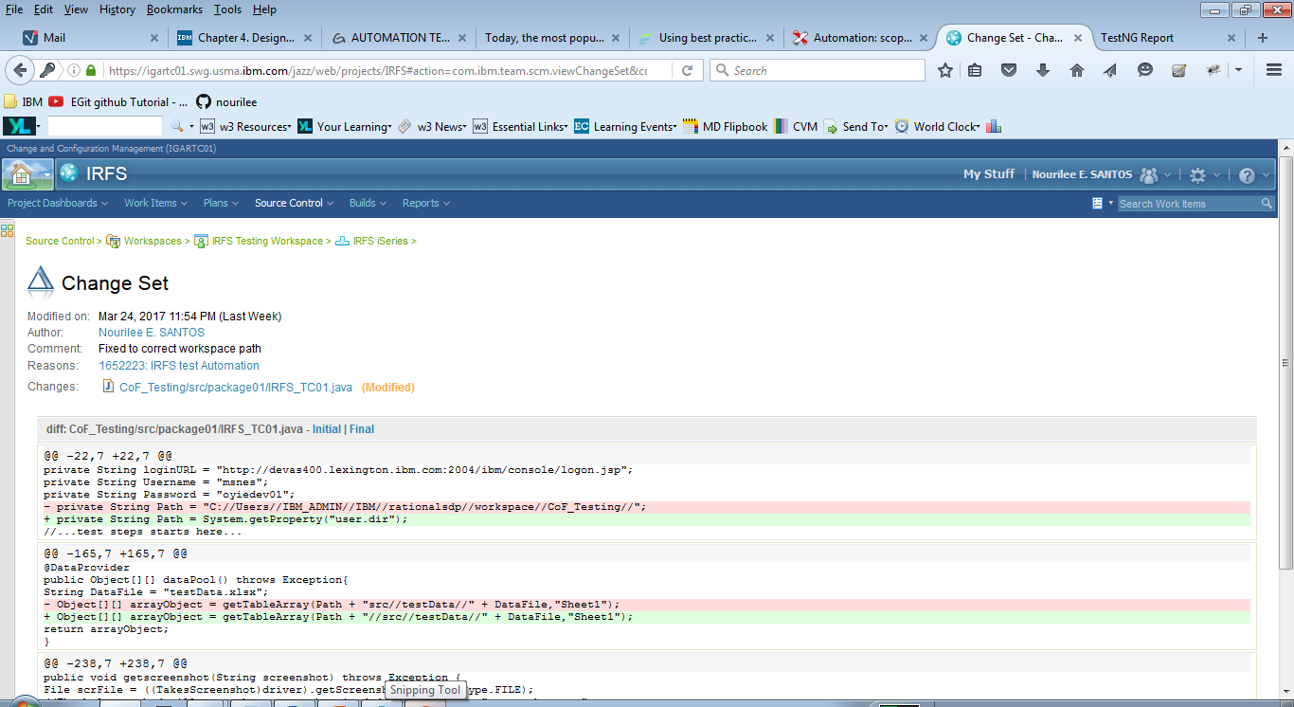
Design and Develop Proof of Concept
Check In & Deliver to RTC
Notes:
Configure RTC integration. Select the project you want to Check-In & Deliver. Select the work item you want to link on your project and then submit.

Slide 12
Demo
Proof of concept

Slide 13
Thank You
© Copyright IBM Corporation 2015. All rights reserved. The information contained in these materials is provided for informational purposes only, and is provided AS IS without warranty of any kind, express or implied. IBM shall not be responsible for any damages arising out of the use of, or otherwise related to, these materials. Nothing contained in these materials is intended to, nor shall have the effect of, creating any warranties or representations from IBM or its suppliers or licensors, or altering the terms and conditions of the applicable license agreement governing the use of IBM software. References in these materials to IBM products, programs, or services do not imply that they will be available in all countries in which IBM operates. Product release dates and/or capabilities referenced in these materials may change at any time at IBM’s sole discretion based on market opportunities or other factors, and are not intended to be a commitment to future product or feature availability in any way. IBM, the IBM logo, Rational, the Rational logo, Telelogic, the Telelogic logo, and other IBM products and services are trademarks of the International Business Machines Corporation, in the United States, other countries or both. Other company, product, or service names may be trademarks or service marks of others.
Notes:
Thank You!

